Slide 1
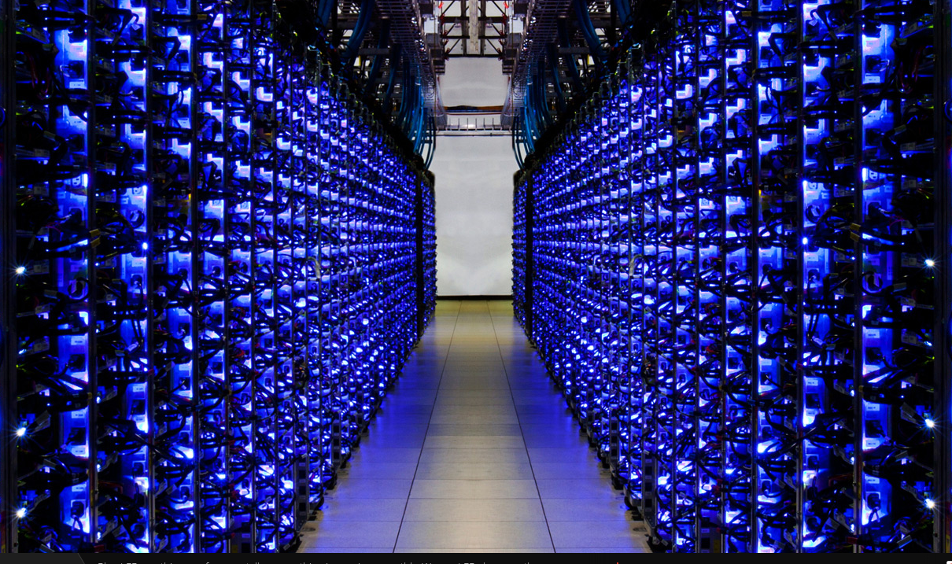

Colocated Data + Computation + APIs

Slide 2
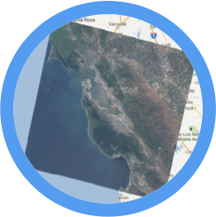

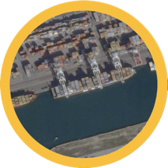
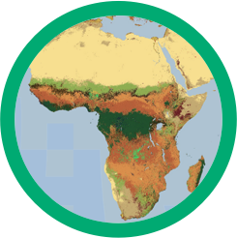

The Earth Engine Data Catalog
Landsat & Sentinel
10-30m, 14-day
MODIS
250m daily
Terra Bella
<1m daily–weekly
Terrain &
Land Cover
Weather & Climate
NOAA NCEP, OMI, ...
... and many more, updating daily!
> 200 public datasets
> 4000 new images every day
> 5 million images
> 5 petabytes of data

Slide 3
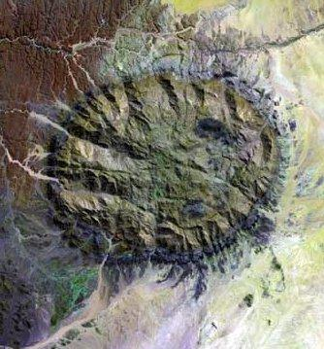
What can Earth Engine do?
Get an image
Pick your: projection, resolution, bands, bounding-box, visualization

Slide 4

What can Earth Engine do?
Get an image
Apply an algorithm to an image
Use library functions or script your own

Slide 5
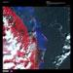
What can Earth Engine do?
Get an image
Apply an algorithm to an image
Filter a collection
Time, Space & Metadata Search

Slide 6
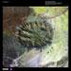
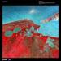
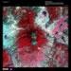
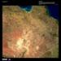
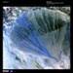
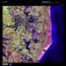
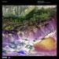
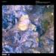
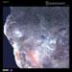
What can Earth Engine do?
Get an image
Apply an algorithm to an image
Filter a collection
Map an algorithm over a collection
N → N

Slide 7
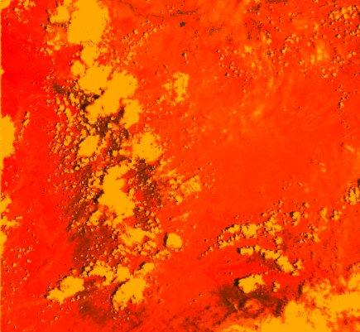
What can Earth Engine do?
Get an image
Apply an algorithm to an image
Filter a collection
Map an algorithm over a collection
Reduce a collection
N → 1 or N → M

Slide 8
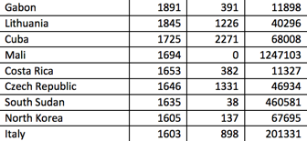
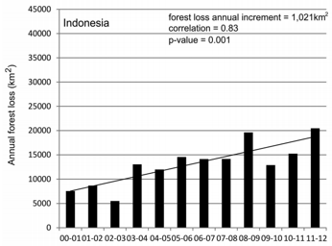
What can Earth Engine do?
Get an image
Apply an algorithm to an image
Filter a collection
Map an algorithm over a collection
Reduce a collection
Compute aggregate statistics

Slide 9
2 Computation Modes
On-Demand Computation
Batch Computation
On-the-fly map tile rendering
Reduce human time: iterate quickly!
Reduce CPU costs: only compute what you actually need!

Slide 10
2 Computation Modes
Batch Computation
Batch Computation
Large-scale computation powered by
Reduce CPU costs: run at batch priority
Reduce serving latency: store all tiles as static resources
Run computations that require analysis of complete data

Slide 11
